Slide 2



Utilizing Connect Sources with Forms
This presentation is CONFIDENTIAL and property of Softdocs, Inc. It is to be used only for the purpose intended. Any unauthorized use is strictly prohibited. © 2017 Softdocs, Inc.

Slide 3
Agenda
Connect Administration
Create Connection
General Settings
Source Assignments
Source Administration
Create Source
General Settings
Source Assignments
Actions
Privileges
Assigning Source to Form
Best Practices
Integration JavaScript
Breakdown of using the Integration JavaScript

Slide 4
Connect Administration

Slide 5
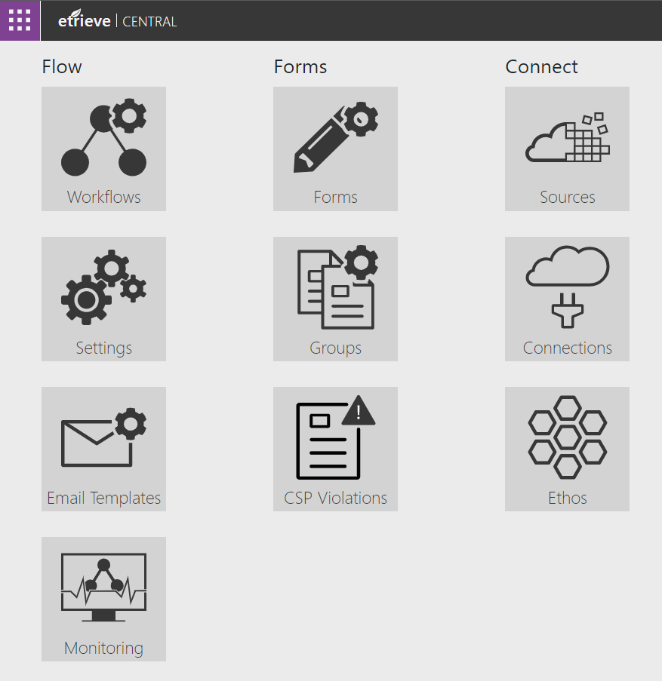
Etrieve Connect
Connections – Configuration to the Database or Web Source (APIs) for Sources
Sources – Actions or Queries used for Forms

Slide 6
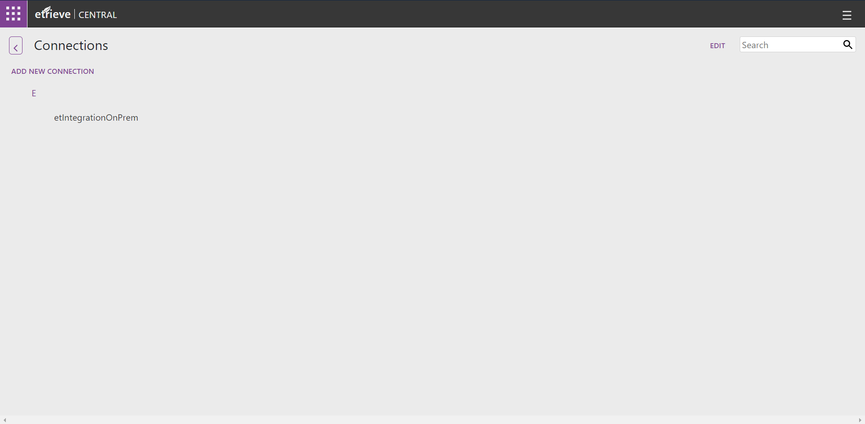
Create Connection
At the top-left, click ADD NEW CONNECTION

Slide 7
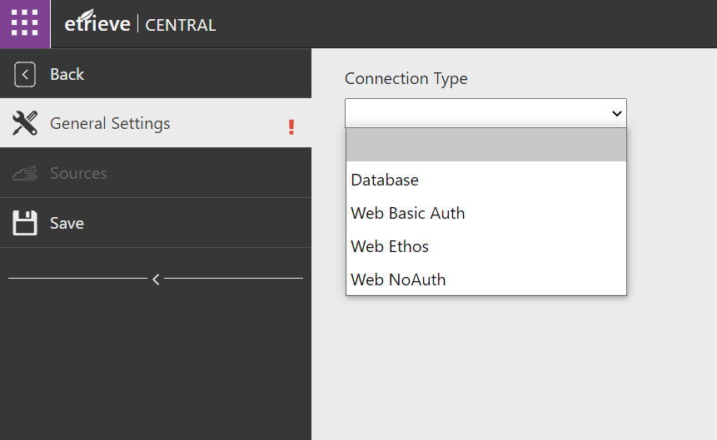
Create Connection
Select the applicable Connection Type
Database – Connectivity to Oracle or SQL Database
Web Basic Auth – Connectivity to Web Sources/APIs that require Username & Password
Web Ethos – Connectivity to Ethos APIs that require API Key & Token URL
Web NoAuth – Connectivity to Web Sources/APIs with no Username/Password authentication

Slide 8
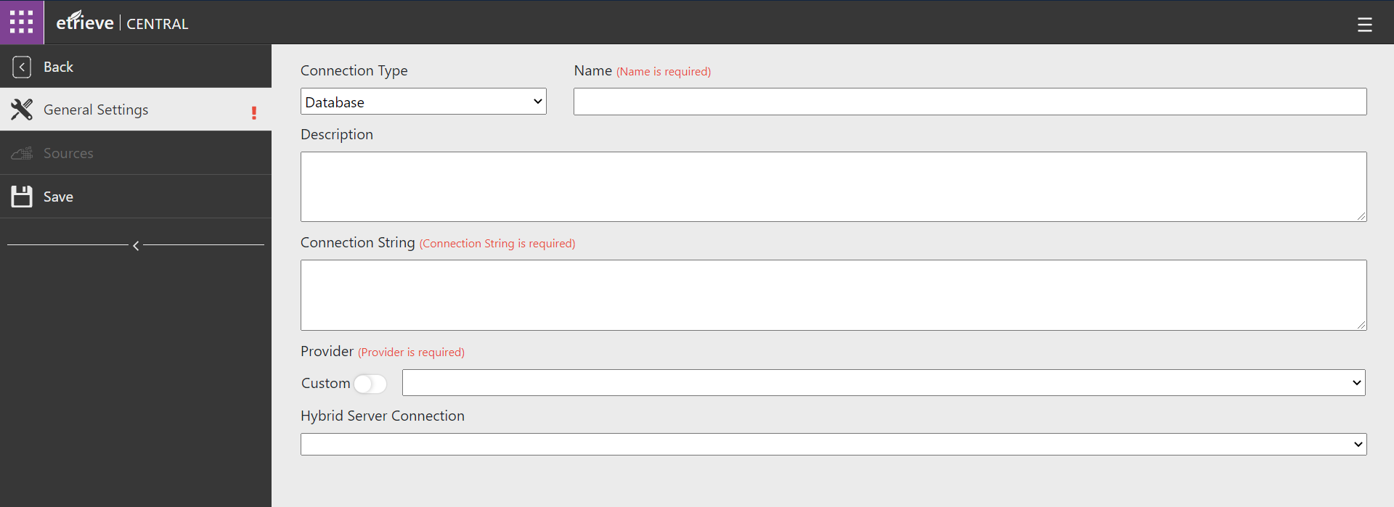
Database Connection General Settings
The setup of the connection is found in the General Settings tab

Slide 9
Connection General Settings
The Name of the connection should identify and describe the Server & Database of the connection.
Enter a Description for the connection.

Slide 10
Connection General Settings
Enter the appropriate Connection String to reach the appropriate Server and Database.

Slide 11
Connection General Settings
SQL Connection String with integrated security
Data Source=SQLServerName; Initial Catalog=DatabaseName; Application Name=Etrieve Integrations; Integrated Security=True;
Uses etAutomationService Domain User as authentication
SQL Connection String with Username/Password
Server=SQLServer; Database=DatabaseName; User Id=Username; Password=UserPassword;
Oracle Connection String with Username/Password
Data Source=(DESCRIPTION=(ADDRESS=(PROTOCOL=TCP)(HOST=hostname)(PORT=1521))(CONNECT_DATA=(SERVICE_NAME=DatabaseName)));User id=username;Password=password

Slide 12
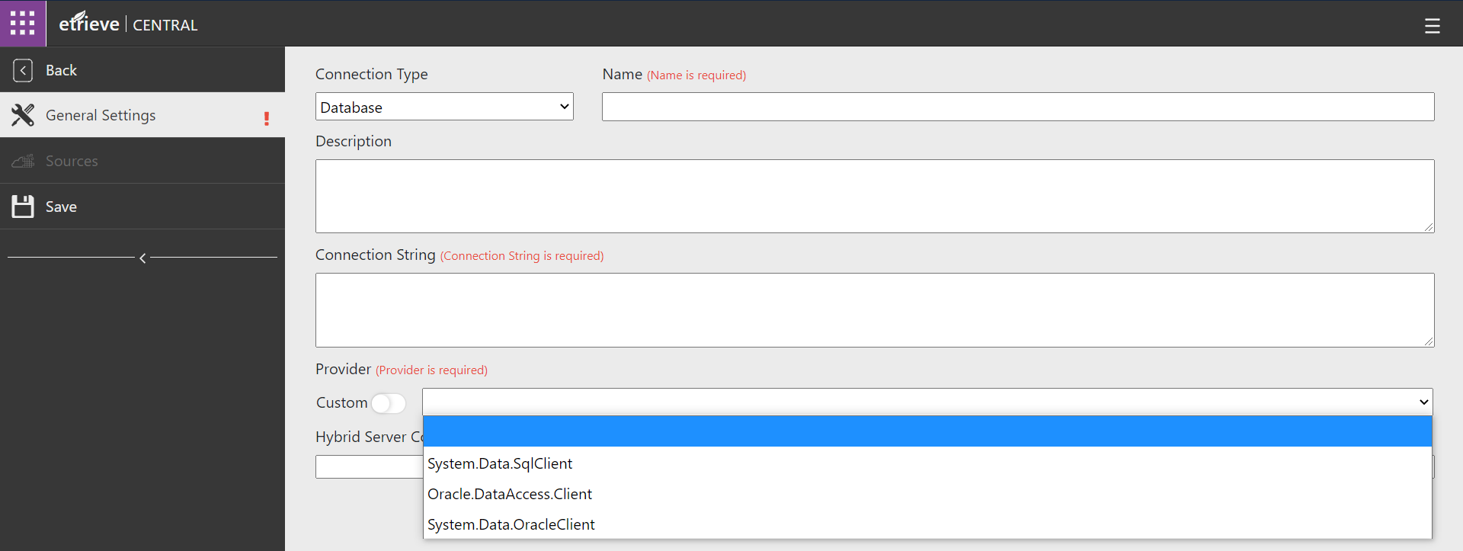
Connection General Settings
Select the applicable Provider for the connection string.
Select Custom in order to enter your own Provider.

Slide 13
Connection General Settings
Hybrid Server Connection is only used for Cloud implementations. Use this to select the connection created to connect to the on-prem hybrid server.

Slide 14
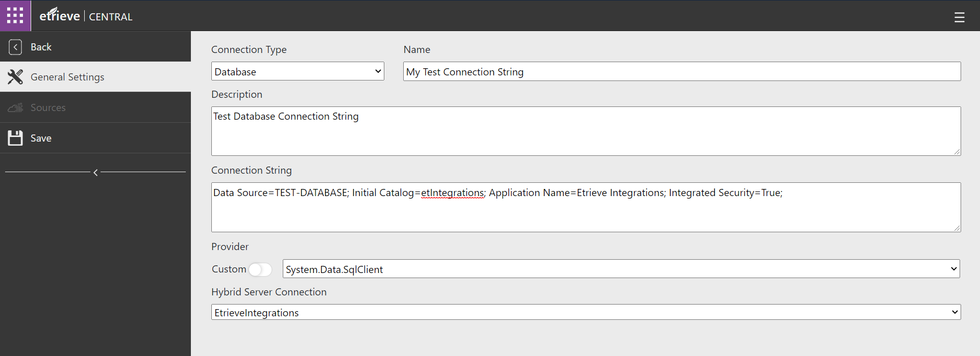
Connection General Settings
Save the connection.

Slide 15
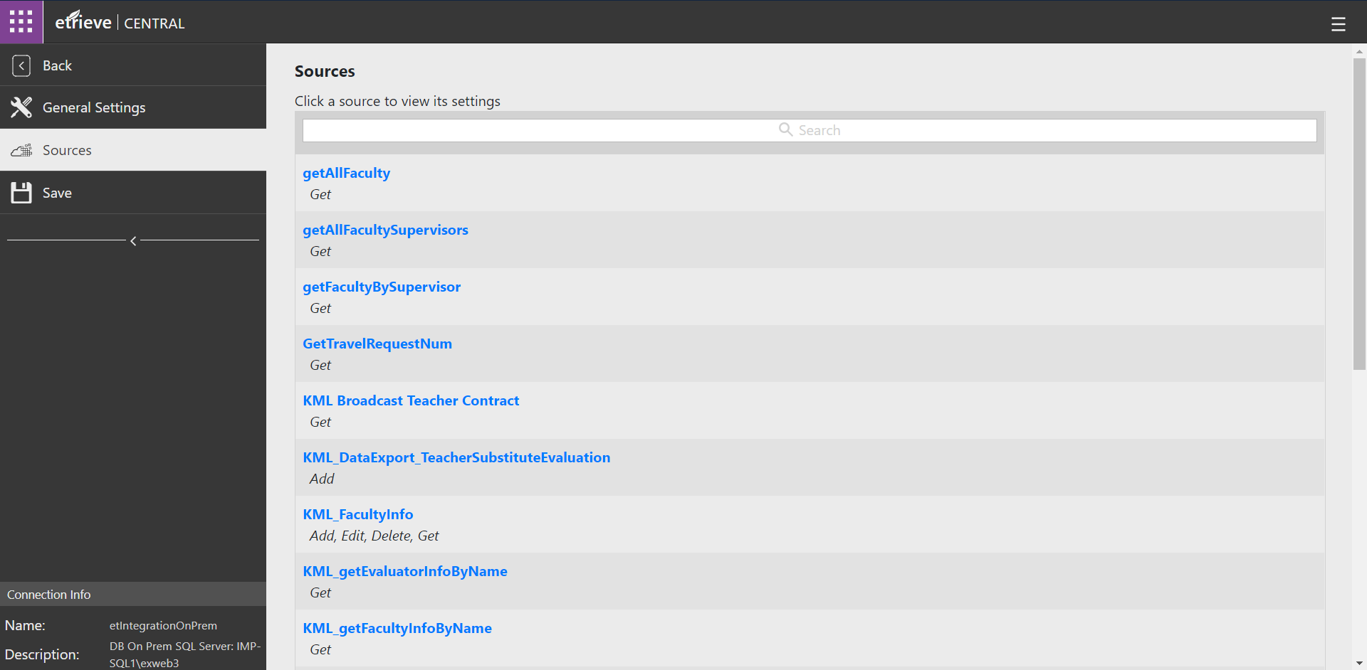
Source Assignments
The Sources tab will display all the Sources that are associated to the connection.
Clicking on the Source will navigate you to that Source’s Administration page.

Slide 16
Create Connect Source

Slide 17
Create Source
In Settings click on Sources

Slide 18
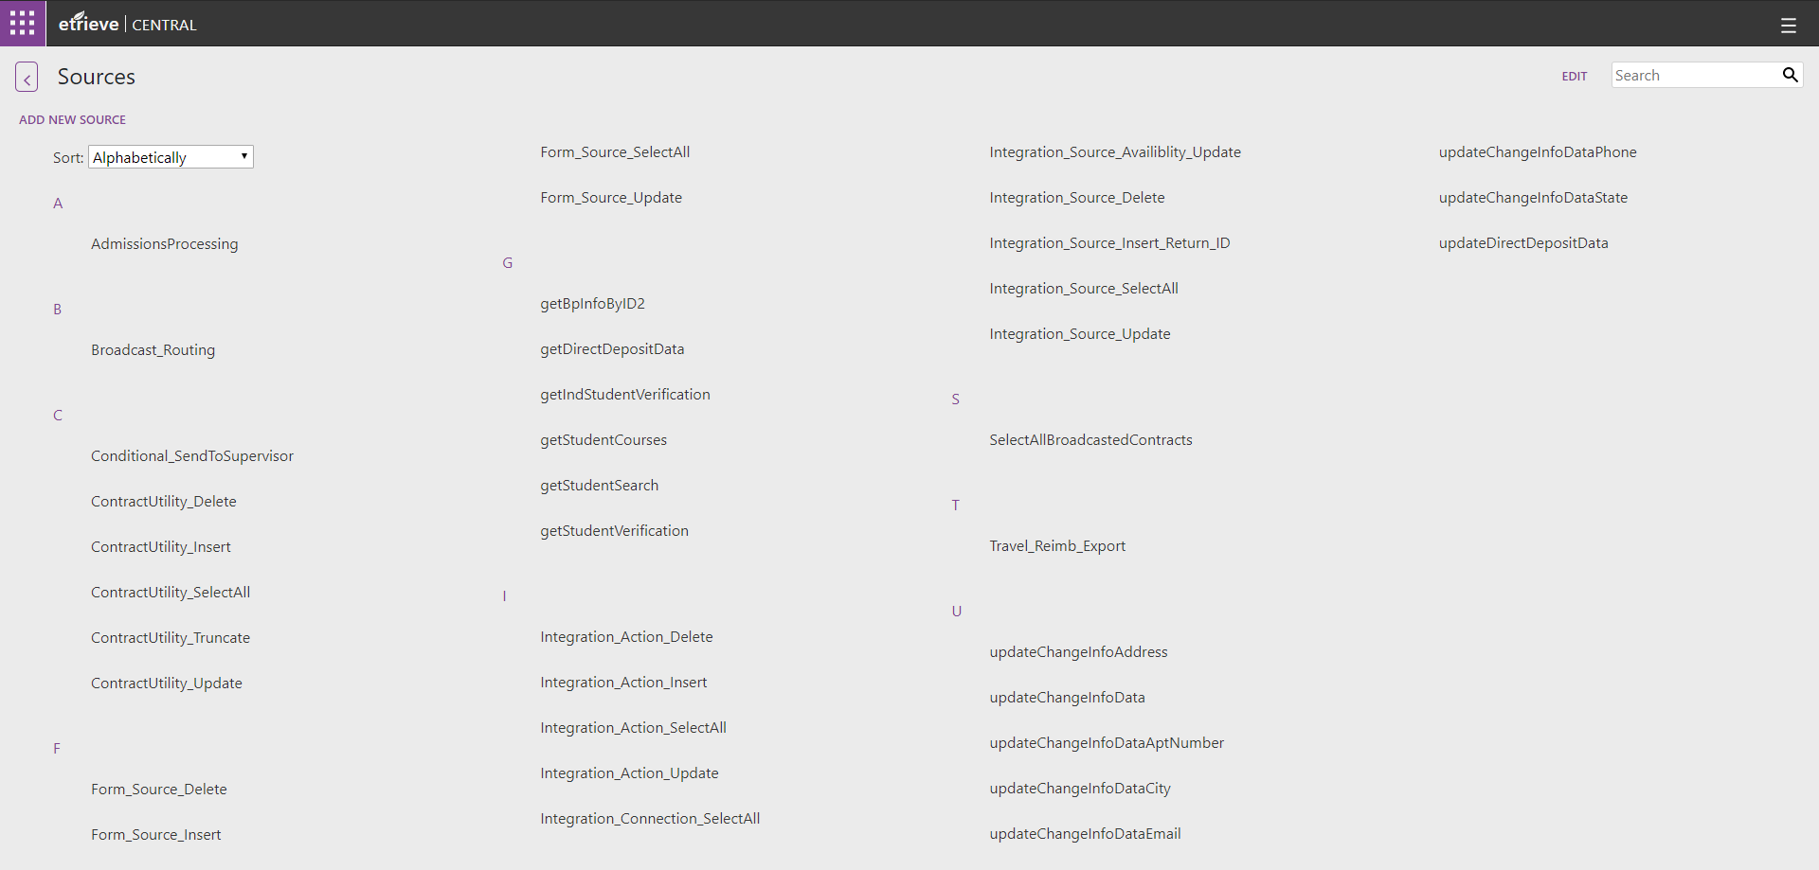
Create Source
At the top-left, click ADD NEW SOURCE

Slide 19
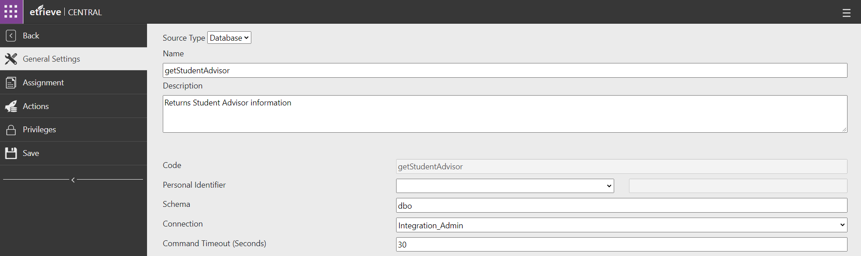
Source General Settings
The General Settings tab displays the basic configuration information of the Source.
Assign a Source name, description, and Connection. Click Save

Slide 20
Source General Settings
The Code field will be populated when the Source is created.

Slide 21
Source General Settings
The Personal Identifier field is used for On Origination or On Load integrations.
The selected value is fed from the user’s Etrieve Security record to the integration as a parameter.

Slide 22
Source General Settings
Identify the table Schema. Only needed if no custom action is identified.

Slide 23
Source General Settings
The Connection the Source will use to connect to the applicable Database

Slide 24
Source General Settings
The Command Timeout field displays the number of seconds that can elapse before the Source will error out if no response is received.

Slide 25
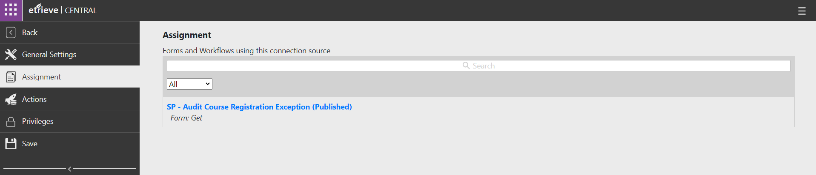
Source Assignments
The Assignment tab displays any Forms or Workflows that use the Source.

Slide 26
Source Assignments
Clicking on the name of an associated Form or Workflow will open that item’s configuration in Central.

Slide 27
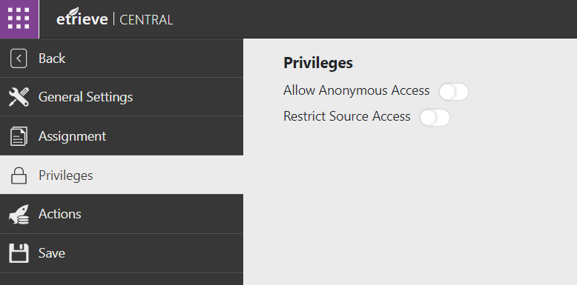
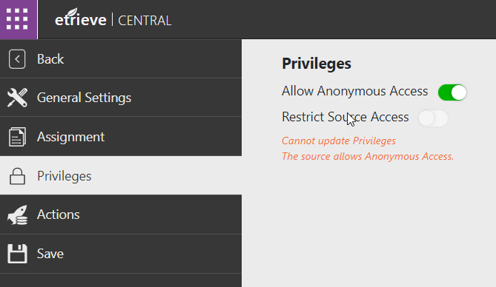
Privileges
By default, all Sources can be executed by any user using the form.
Privileges can be assigned to Sources to restrict access to specific Etrieve Security Users or Roles.
If Privileges have been assigned to a Source, only the named Users and Roles will have access to execute the Source.
To add Privileges to a Source, click the Restrict Source Access toggle on the Source’s Privileges tab.
To allow the source to be used on an anonymous form, click the Allow Anonymous Access toggle on the Source’s Privileges tab.
Sources cannot allow Anonymous Access and have Restriction simultaneously.

Slide 28
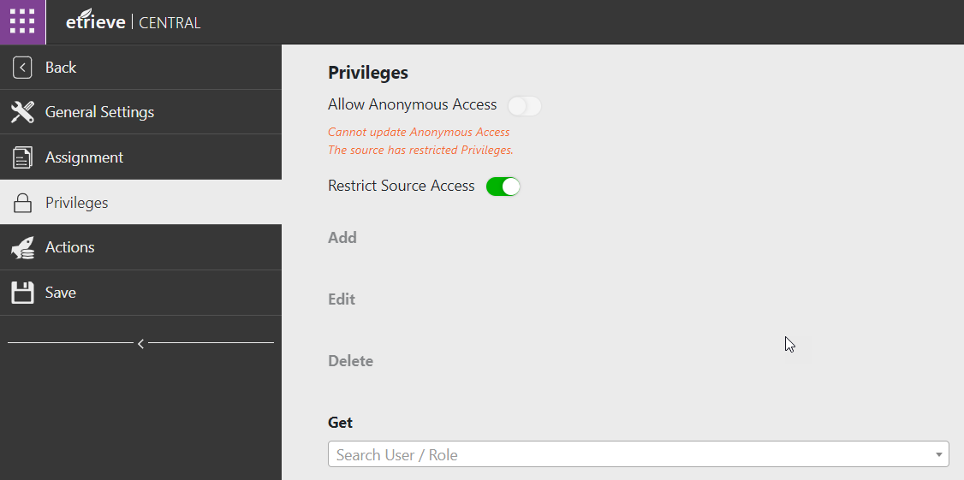
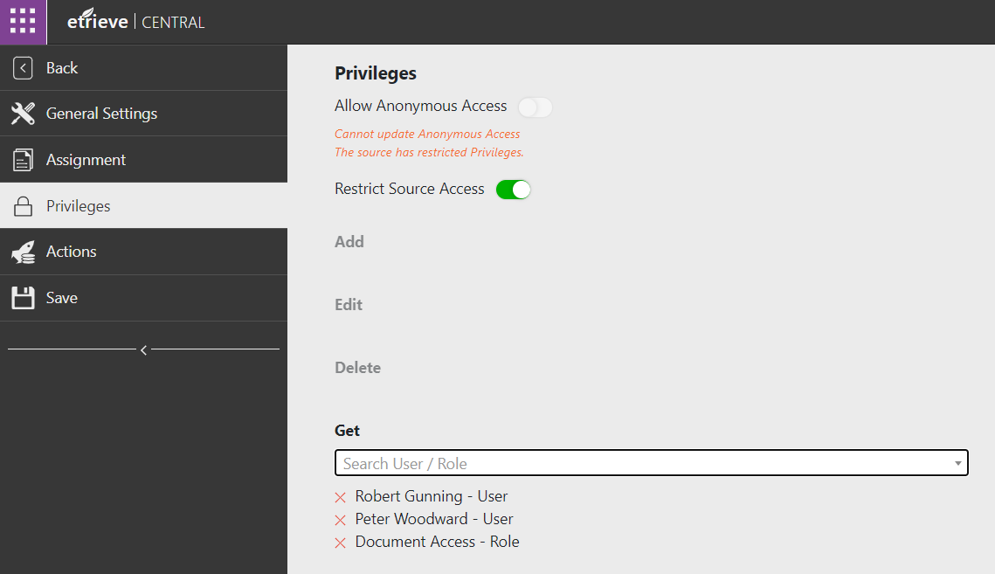
Privileges
Once Privileges have been activated for the Source, allow access for Users or Roles by selecting them from the Search field for each associated Action.
Assigned Privileges can be revoked by clicking the red X next to the listed User or Role.

Slide 29
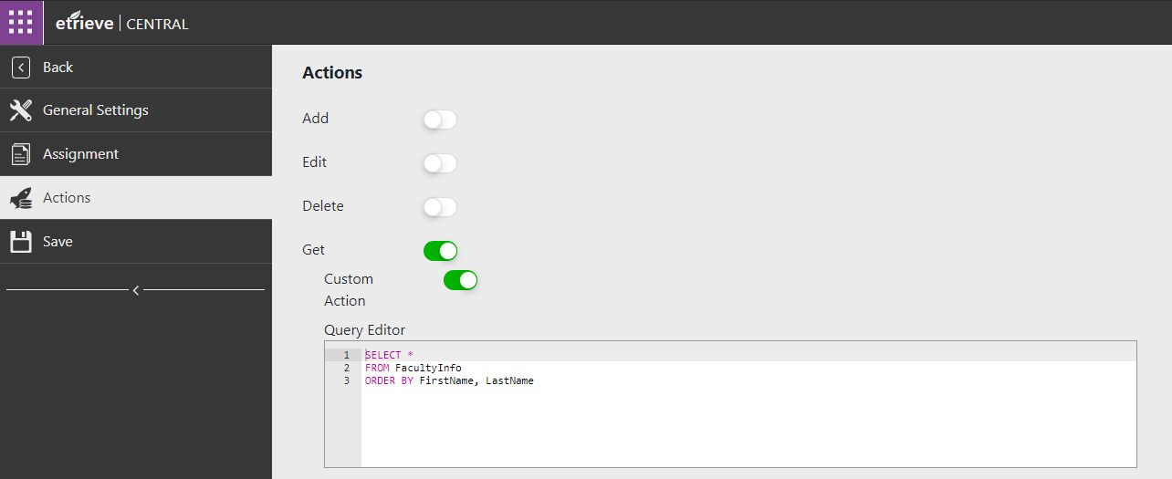
Actions
Sets the action type(s) for the Source
One Source can have multiple Actions
1. Insert statement
2. Update statement
3. Delete statement
4. Select statement
1
2
3
4

Slide 30
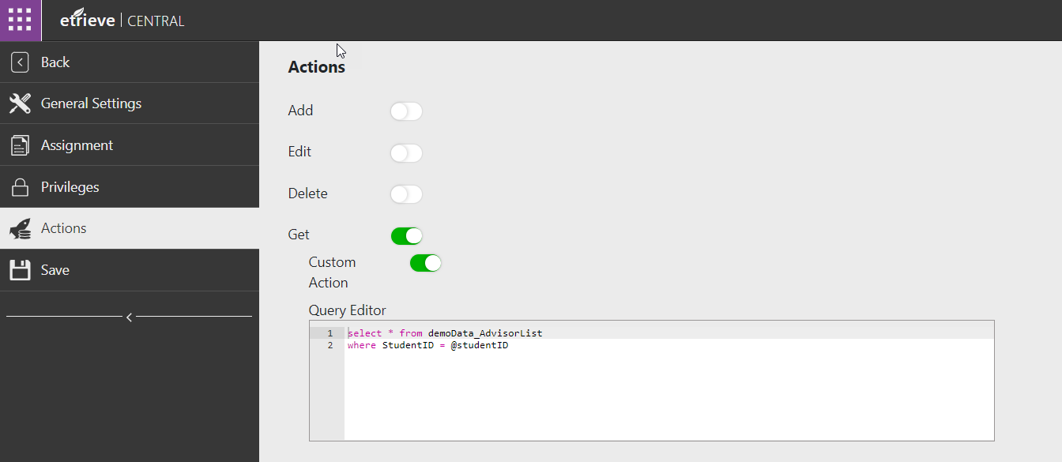
Actions
To enter a custom query, select “Custom Action” and enter the query in Query Editor. Click Save.

Slide 31
Assign Source to Form

Slide 32
Assign Source to Form
In Settings click on Forms

Slide 33
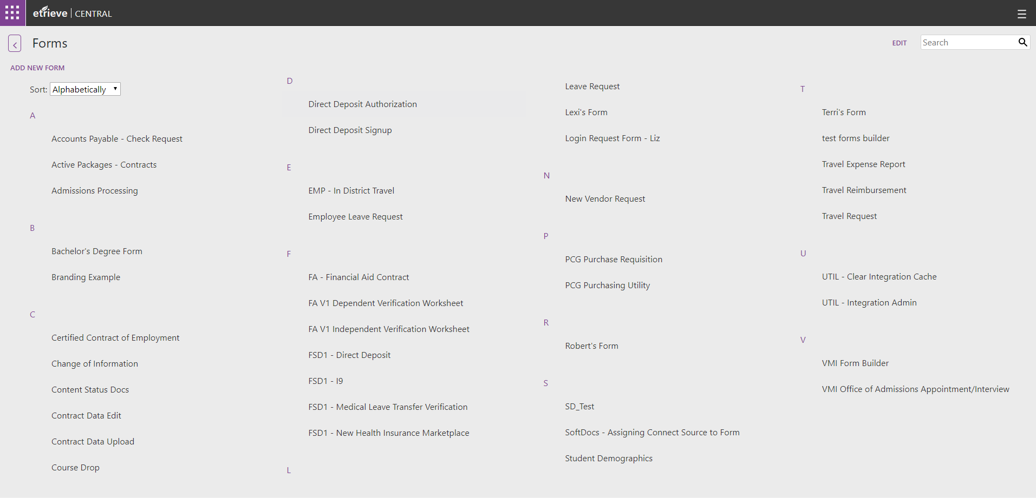
Assign Source to Form
Select your form

Slide 34
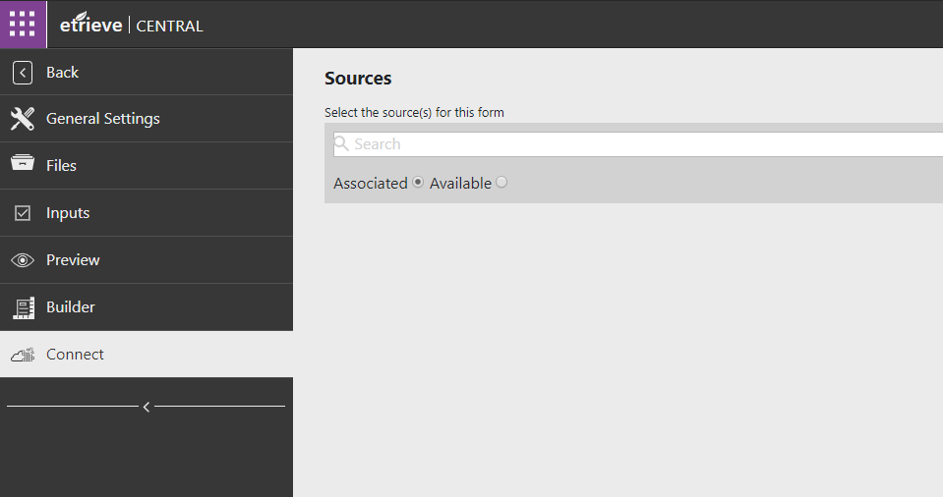
Assign Source to Form
Once in form, select Connect tab.

Slide 35
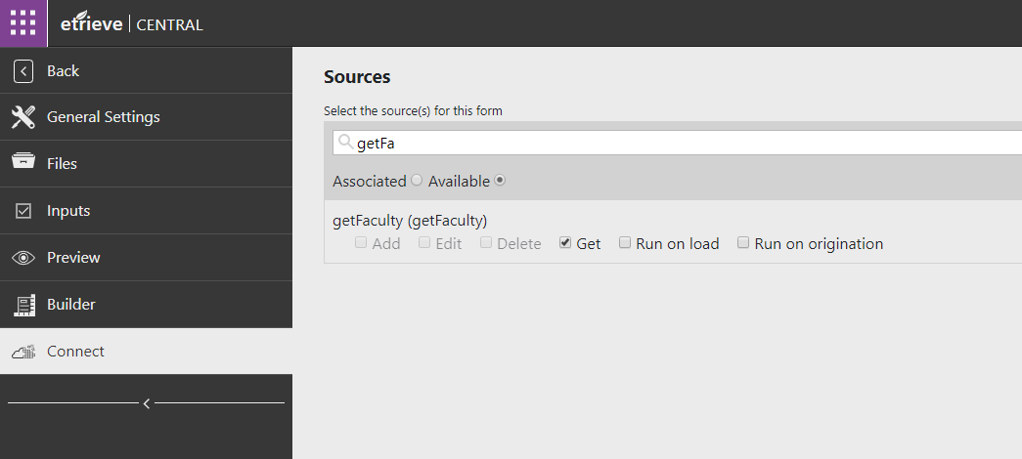
Assign Source to Form
Toggle the Available radio button to view the available sources
Search for the Source and select the action type.

Slide 36
Best Practices

Slide 37
Best Practices
Test queries in SQL/Oracle first
Testing a query for the first time on a form may result in timeouts or errors that are hard to diagnose through Etrieve.
Configure Source names that define the action
Provide words like get, add, update, or delete with a small description of what the Source’s action is doing.
e.g. “Get Student Demographic By Email” or “Get Employee Supervisor By ID”
Include words like “CondActor” for Conditional Actors and “DataExport” for Data Export sources.

Slide 38
Integration JavaScript

Slide 39
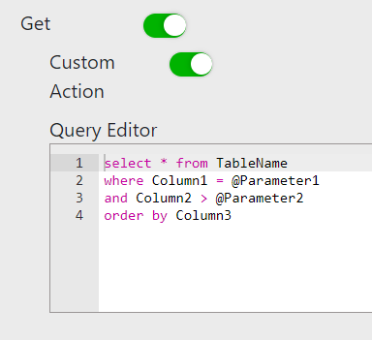
Integration JavaScript
Example Source Action
first = return first row of data
all = return all data
add = insert action source
update = edit action source
delete = delete action source
Code of the Connect Source
integration.all('IntegrationSourceCode',{
Parameter1: 'data',
Parameter2: vm.FieldIDOnForm()
}).then(function (ReturnedDataFromSource) {
});
Getting field data from form
Variables used in the source action query
Array variable for the data returned from the Source

Slide 40
Testing Connect & Source

